Slide 2
Overview
A 5-year bilateral integrated nutrition program, implemented in Zanzibar and Tanzania mainland
Consortium Partners
Africare (Prime)
COUNSENUTH
The Manoff Group
Deloitte Tanzania
Geographic coverage
Manyara, Morogoro and Dodoma regions
8 Shehias in Chakechake, North A and Micheweni districts

Slide 3
MBNP Program Goals
The Challenge
On Tz Mainland
53% of women in Tanzania are anemic.
42% of Tanzania’s children under 5 years of age are stunted.
In Zanzibar
58.7% women are anemic
30.2% children are stunted
Source:
Support the Government of Tanzania to implement its National Nutrition Strategy focusing on:
Reducing maternal anemia by 20%
Reducing child stunting among children 0-59 months by 20%
Building local institutional capacity for scale up and sustainability of nutrition interventions (Government & CSOs)

Slide 4
MWANZO BORA RESULTS FRAMEWORK
FtF Goal: Sustainably Reduce Global Poverty & Hunger
MBNP Objective: Improved Nutritional Status
of women and children <5 focusing on Reduction in the Prevalence of Maternal Anemia and Childhood Stunting
IR3: Increased
Investment in
(Agriculture &) Nutrition-
Related Activities
IR 5: Improved
Access to Diverse & Quality Foods
IR6: Improved
Nutrition-Related
Behaviors
IR7: Improved Utilization
of Maternal & Child Nutrition Services
IR8: Improved Enabling Policy Environment for both Agriculture & Nutrition
Sub-IR6.1:
Improved knowledge and attitudes, gender norms about specific maternal and child nutrition practices
IR3.1: Increased GOT Budget Allocations for Nutrition
Interventions at national and district level
5.1: Increased Consumption of nutritious foods by women and Children at the household level
Sub-IR7.1:
Improved quality of maternal and child nutrition services at the health facility and community
IR 8.2: Strengthened Institutional Capacity of TFNC, COUNSENUTH, PMO, District Nutrition Multi-Sectoral Committees and CSOs

Slide 5
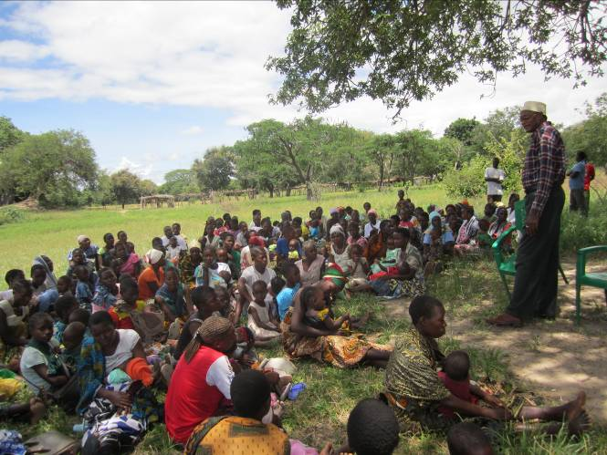
The Beneficiaries
450,000 children Under Five Years of Age
750,000 Women of Reproductive Age
750,000 Men and the community at large

Slide 6
2010 TDHS Data on Maternal Anemia
Prevalence of anaemia among pregnant women
Nation-wide: 53%
Dodoma: More than 1 in 4 (28%)
Manyara: More than 1 in 4 (27.1%)
Morogoro: Nearly half (45%)
Zanzibar: 58.7%
Maternal anemia is associated with:
Inadequate intrauterine growth
Preterm delivery and Maternal & fetal deaths
Percentage of maternal death associated with anaemia:
Dodoma: 13% Manyara: 11%
Morogoro: 29% Zanzibar: 23%

Slide 7
Critical Pathways Affecting Maternal Anemia
Current Situation (2010 TDHS)
96% of pregnant women report at least 1 ANC visit
34% of pregnant women first attend ANC during their final trimester
Only 56% of women report taking iron in pregnancy
Only 4% of pregnant women who report taking iron take minimum required 90+ tablet
71% of calories in household diet is from staple foods
Only 35% of women with children under 3 consume iron-rich foods
Only 61% of children under 2 years receive complementary food with 3+ food groups (MAD)
Only 30% of children under 3 years consume iron-rich foods
10% of households have home gardens
IRON STATUS
Iron intake | Iron Loss | Iron Stores
Iron-rich foods and absorption enhancers Animal-source foods, especially meat Fruits (vitamin C, acidic foods) | Worms Malaria Shistosomiasis | Frequent pregnancy depletes Iron stories
Iron absorption inhibitors Tea High-fiber foods (e.g., maize meal)
Pregnancy issues
Blood volume Expansion
Boots and gloves
Pesticides
Deworming
LLITN
IPTp
Family Planning
IFA supplements in pregnancy)
Agriculture-Nutrition Dietary Practices
Household Actions
Discuss & decide together about allocating household resources
Grow & raise small animals, fish, eggs, mangos, oranges, green leafy vegetables
Use agriculture income to buy iron-rich foods
Process , preserve & store foods
Help women to rest & eat more iron-rich foods
Sleep under a longlasting insecticide-treated bed net
Attend ANC no later than 2nd trimester
Adhere to iron-folate supplementation (90+ tabs)
Ask for and take IPTp (2 SP doses during pregnancy)
Ask for and take Deworming medicine
Practice healthy timing and spacing of pregnancy
Agriculture-Nutrition Extension Services
Antenatal Care
Postnatal Care
Agriculture Extension
Optimal plant spacing, population, and field preparations, and farm calendar
Improved crop , seed varieties, fertilizer and pesticides
Improved postharvest storage, processing and preservation technologies
Appropriate animal husbandry technologies
Ensure availability /provision of pesticides and protective gear
SBCC
Health Services
Ensure availability/provision of:
IFA tablets
Deworming medicine
SP for IPTp
LLITN
Maternal Nutrition SBCC
Ensure availability/provision of:
IFA tablets
LLITN
Family Planning
Maternal Nutrition SBCC
Enhanced Gender Roles, Social Change, Strengthened Policy Environment
Notes:
Edits needed to this graphic:
“Enhanced Gender Roles, Social Change, Strengthened Policy Environment”: Should run across the entire bottom margin of the page.
“Health Services” box: Should be placed in-between the bottom green box (the box with “Optimal plant spacing”) and the bottom left white box (the one that says Ensure availability/provision of “IFA Tablets”
Overall diagram needs improving for aesthetics but should remain simple and easy to read.
To improve attractiveness, need to include some close-up photos of farmers ideally man/woman couple, man on one side, woman on the other side, or family. They should be in a field or else wearing something that shows they are farmers (have a hoe in their hand or holding crops)

Slide 8
TDHS 2010 Data on Child Stunting
Prevalence of childhood stunting among children under-five years of age:
Nation-wide: 42%
Dodoma: Over half (56%)
Manyara: Nearly half (46.3%)
Morogoro: Nearly half (44.4%)
Zanzibar: 30.2 %
Childhood stunting is associated with:
About 14% loss of life time earning
Reduced physical capacity and productivity
Lower thinking and learning capacity
Poor school attendance and performance

Slide 9
Childhood Stunting
Birth Weight
Food and
Nutrient Security
(including iodine consumption)
Caring Practices
Immediate and exclusive breastfeeding 6m
Complementary feeding frequency, quality, amount
Feeding during/after illness
Food preparation
Home fortification
Health care-seeking
Health Services
Immunization
Prevention/control of
Malaria
HIV
ARI
Anemia
Diarrhea control
Vitamin A deficiency
Immediate Causes
Maternal stature
Maternal health & nutrition
Indoor smoke / tobacco smoking
Family planning
Water sanitation, hygiene
HH Environment
Enhancing Positive Male Roles
Maternal education and access to information
Vulnerability factors (e.g., alcohol, single parent)
Access to services
Community & Environment
Social exclusion
(e.g., gender bias, ethnic bias)
Perceptions of child growth and health
Governance, awareness, support for social sectors
Local ecology

Slide 10
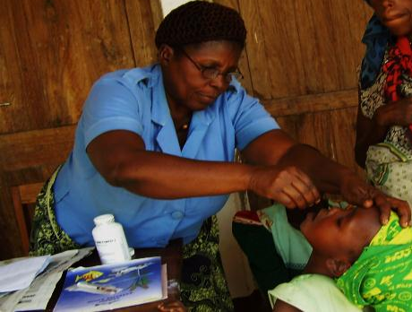
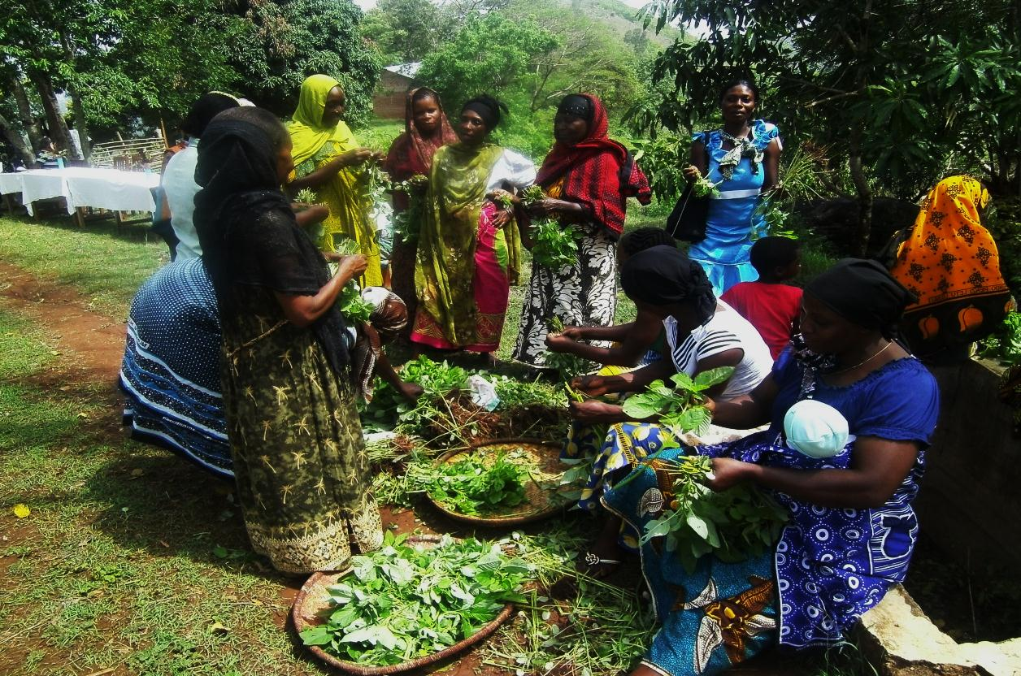
Institutional Capacity Building
SBCC
Mwanzo Bora focuses on Siku 1000 - the first 1000 days of the life of a child from conception
Delivery of Nutrition Services
Community Nutrition interventions

Slide 11
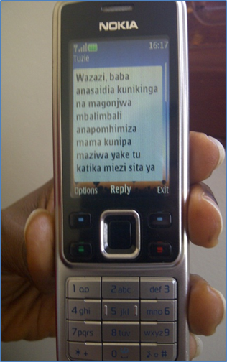
Achievement to date: SBCC
Developed two multimedia SBCC kits: One for Parents and CHWs and another one for Farmers and Agriculture Extension workers
Provided technical Assistance to TFNC to develop the National SBCC Strategy
Implemented an SMS breastfeeding campaign reaching 8,000 recipients

Slide 12
Achievement to date: Institutional Capacity Strengthening
Completed Comprehensive Institutional Capacity Assessments for TFNC and Counsenuth
Provided SBCC mentorship and on-the-job training for Counsenuth and TFNC staff
Completed different core institutional capacity development milestones for Counsenuth, focusing on organizational systems and structures
Engaged 10 CSO sub-grantees to implement community nutrition programs in10 districts
Signed contract with the Government of Zanzibar as sub-grantee to MBNP

Slide 13
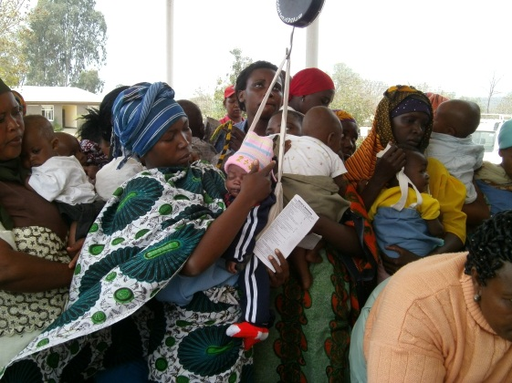
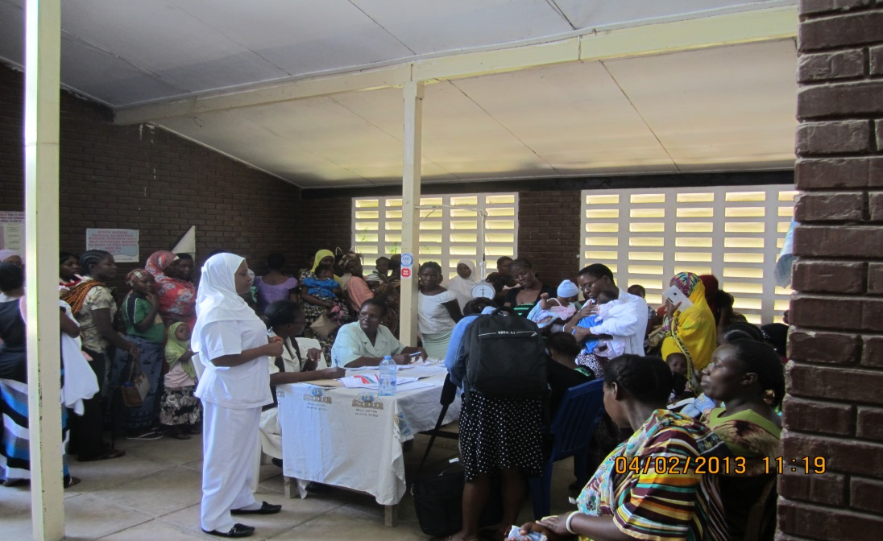
Achievement to date: Delivery of Nutrition Services
Trained 246 Health workers from 180 health facilities, who delivered:
Quality Nutrition Services to 350,998 children
Vitamin A supplementation to 159,636 Kids
Procured and distributed medical equipment to support delivery of nutrition services at 180 health facilities
Prepared and distributed training materials and job aids to support quality service delivery

Slide 14
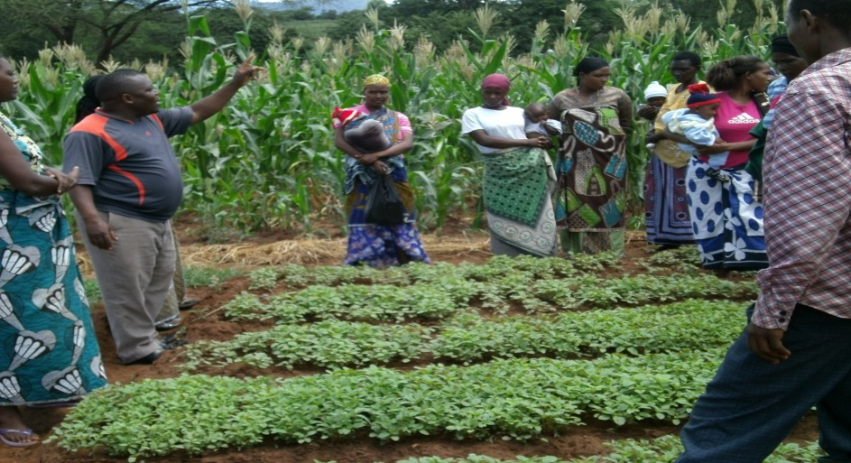
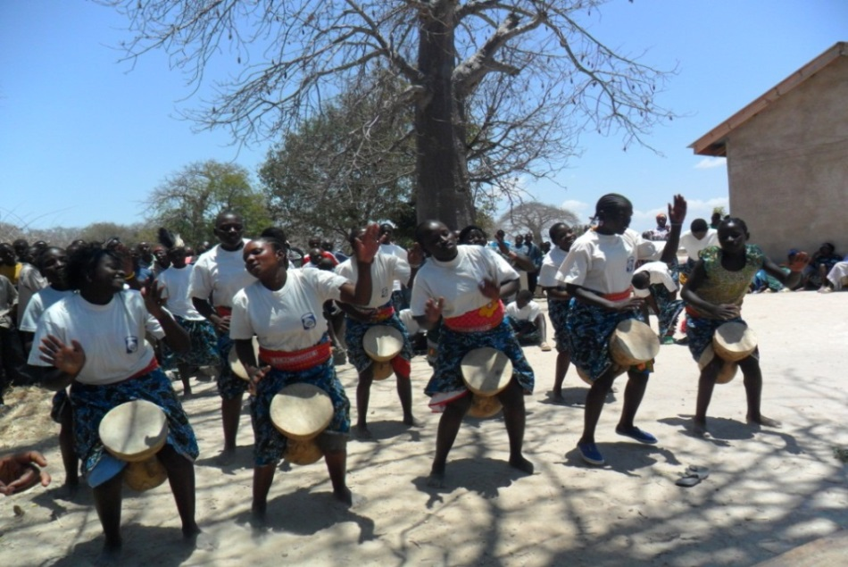
Achievement to date: Community Nutrition activities
Established 20 demo plots to demonstrate and promote home gardens
Trained 93 Nutrition Technical Facilitators at district level to cascade the program
Trained 709 Community Health Workers
Trained 650 Community Leaders
Trained 224 Extension Workers
Formed 1,056 Peer Support Groups; and mobilized 6,014 people into social networks to support pro-nutrition behaviors; nearly half of them (46.7%) are men
Cultural Groups delivered nutrition messages through community drama at community level

Slide 15
Summary of key results
Indicator | Achievement in Y1 | Cumulative to date
Number of people trained in child health and nutrition through USG supported programs | 669 | 3,490
Number of children under five reached by USG funded nutrition programs | 96,557 | 350,998
Number of children under five who received Vitamin A from USG funded nutrition program | 78,639 | 159,636

Slide 16
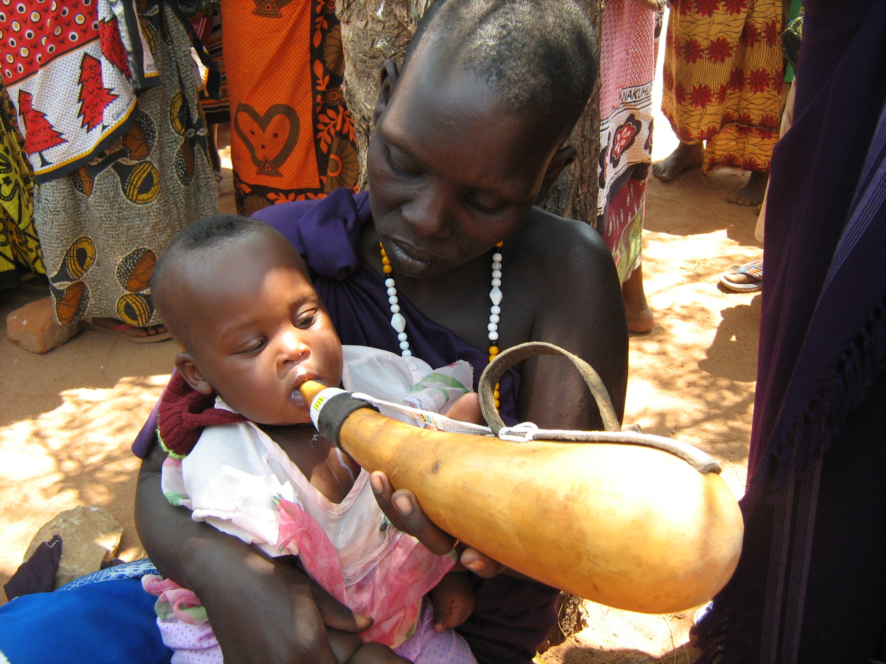
THANK YOU

